Slide 1
Europe, let's
cooperate!
Interregional cooperation forum
20-21 March 2024
Antwerp

Slide 2
Europe, let's cooperate!
Interregional cooperation forum
20-21 March 2024, Antwerp
Agenda - 20 March 2024
14:00-17:00
Networking and inspiration for project preparation
Interreg Europe corner
Country corners
Networking tables
Individual meetings with the joint secretariat
Study visits*
Project poster exhibition
'Let’s talk' corner
Next steps towards new interregional cooperation projects
Keynote speech on strategic foresight
Networking cocktail
* outside the venue
09:30-10:00
10:00-11:00
11:00-11:30
11:30-12:30
12:30-14:00
Registration
Celebrating the power of interregional cooperation
Coffee break
Cooperation in action: get ready for the third call
Lunch break
17:00-17:10
17:10-17:30
17:30-19:00
See the full agenda and additional details on the event website
www.interregeurope.eu/event/europecooperates2024/programme

Slide 3
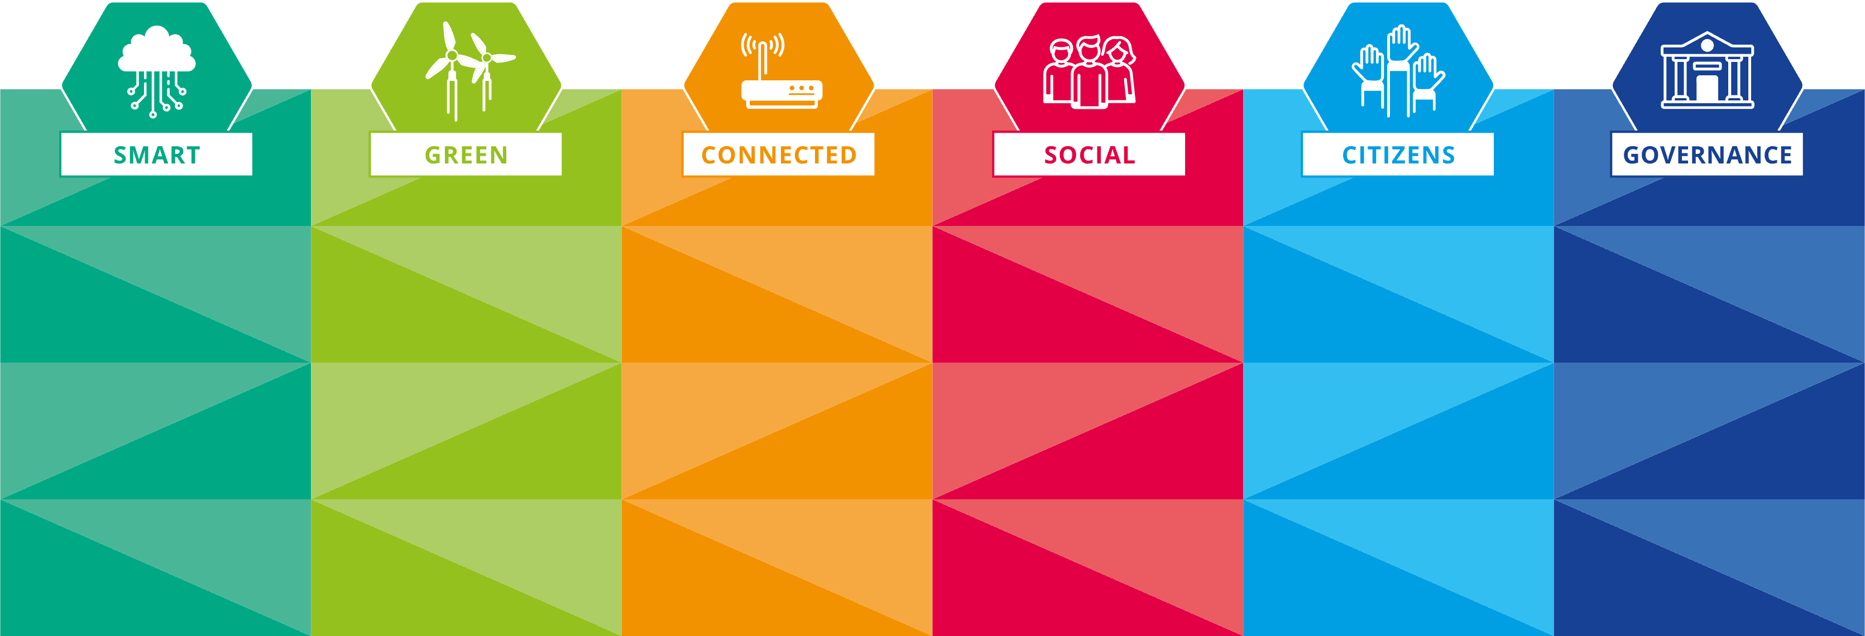
Key note speech on strategic foresight.
Peter De Smedt, Flanders Chancellery and Foreign Office
(Government of Flanders)

Slide 4
CONTENT
Strategic Foresight
OECD Blueprint Flanders for practical guidance
Illustrations of foresight initiatives

Slide 5
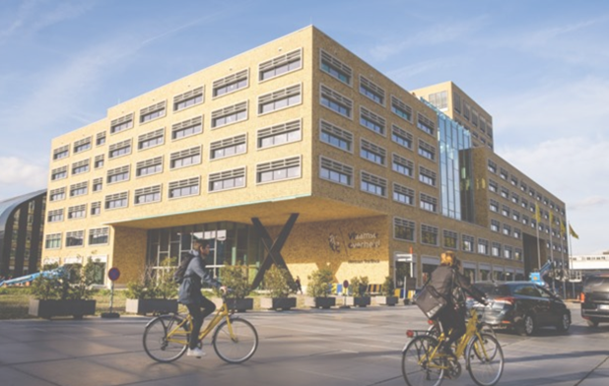
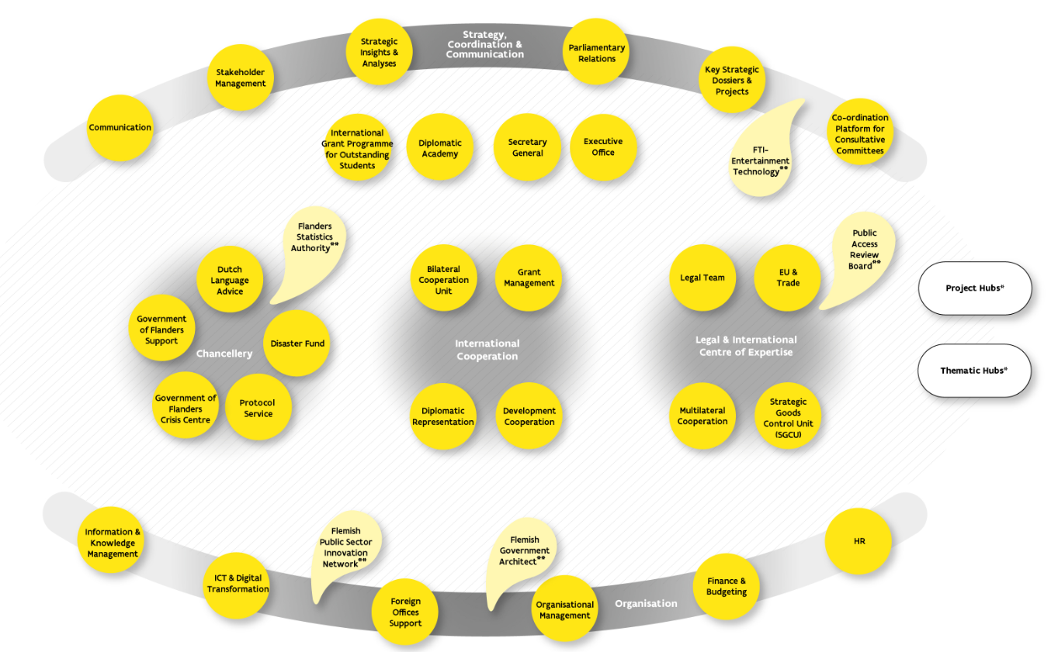
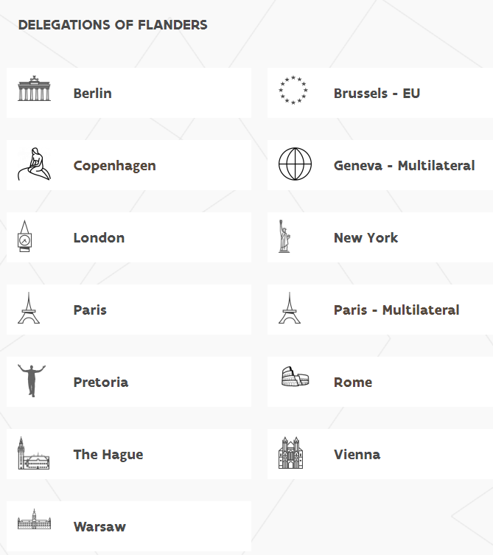
Chancellery & Foreign Office
European regulations international treaties
International and European trade policy
Development cooperation
Better regulation policy
Strategic Insights & Analyses
Strategic goods control
Communication and reputation policy
Evidence Informed Policy
Flanders Chancellery and Foreign Office cooperates with Flanders Investment & Trade and Visit Flanders to realise its’ international ambitions

Slide 6
Strategic Foresight
Why the future is important
The future is open, emergent and rich in possibilities… but not only. The future is also uncertain and complicated.
The future can neither be measured nor predicted. No facts or evidence of the future exist. Some near futures seem probable, and others although possible, may never materialise.
The future matters and not all futures are preferred. Actions or lack of actions today, will have consequences both on shaping near futures and on anticipating any future that will unfold.

Slide 7
Strategic Foresight
Concept
Observing and analysing the future as it emerges to identify and act upon multiple futures which gives an intelligence base for strategic planning, adaptation and transformation
Enables governments for effective anticipation of both emerging opportunities and potential adverse effects, facilitating the formulation of forward-looking policies that align with the evolving needs and expectations of society
Instrumental in stress-testing current systems, facilitating structural changes, and guiding innovation based on global trends and potential future crises

Slide 8
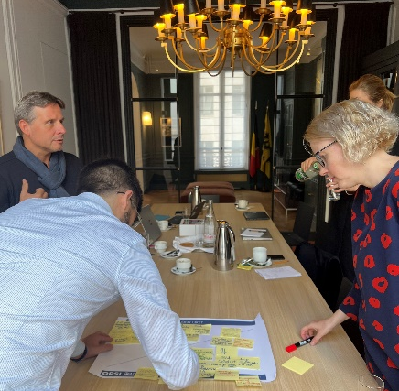
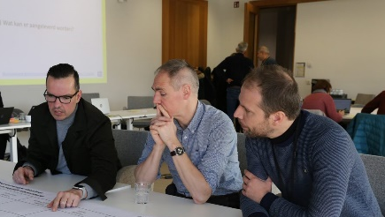
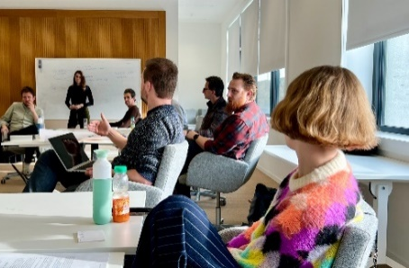
Strategic Foresight
for Resilience initiative
Anticipatory Intelligence to create strategic insights of explorative futures, visions and possibilities for transformative change
Contributing to evidence-informed and future-proof decision making in a volatile, uncertain, complex and ambiguous world
Anticipatory Intelligence is leveraged across boundaries of time, scale and function, including strategic foresight tools like horizon scanning, scenario analyses and visioning to discover, explore, map and create
Knowledge exchange and skill development with different actors within and outside the government at regional, European and international scale

Slide 9
Strategic Foresight
for Resilience initiative
Discover
Explore
Four functions to enable organisations and teams to engage with Strategic Foresight
These functions provide an answer to challenges and needs, and they increase the quality in design and delivery of foresight activities and outputs
Trends and disruptions
Trend analysis
Weak signals
Causal Layered Analysis
Anticipatory intelligence
Horizon scanning
Patterns & system analysis
Science-to-Policy dialogues
Map
Create
Opportunities & challenges
Futures wheel
Explorative scenarios
Resilience indicators
Impact and scale
Visions
Roadmaps for action
Coalitions for the future

Slide 10
OECD Blueprint
Strategic Foresight in Flanders
FOUNDATIONAL ELEMENTS
VISION & MISSION
The Flanders Chancellery and Foreign Office‘s vision ensures that public administration can future proof policies and services with the purpose of improving their resilience by adopting evidence-based, inclusive and systemic approaches. The mission is to empower policy makers with actionable approaches that mobilise activities and tools.
ENABLING ENVIRONMENT
I. Mandate: endorsed and legitimised by
high-level sponsors.
II. Capacity-building: sustained initiatives to spread and improve skills among public servants and managers.
III. Communication: communicated in accessible ways and its value made visible to target audiences.
Provides an overview of foundational elements and strategic drivers
Collaboration between the OECD and the Government of Flanders (Strategic Insights and Analyses)
Informed by an OECD assessment of strategic foresight within the policymaking system in Flanders
STRATEGIC DRIVERS
BLUEPRINT
Strategic direction through prioritisation of its usefulness for policy making including seven roles that Strategic Foresight plays:
Promoting stakeholder engagement
Supporting proactive/prospective Government
Adopting evidence-informed approaches
Designing robust and resilient policies
Enhancing agility, flexibility and innovation
Encouraging learning cycles
Spearheading multi-level dialogues on futures
Driven by these roles, Flanders can put in motion a roadmap for multi-level strategic foresight

Slide 11
OECD Blueprint
Strategic Foresight in Flanders
Principles - Activities - Outputs/tools
Enabling factors
Expectation Management: negotiate clear principles, activities and outputs before, during and after foresight process
Ensure a balanced internal/external capacity (incl. skill development)
Challenge
Structural mandate (versus fragmented/project based)

Slide 12
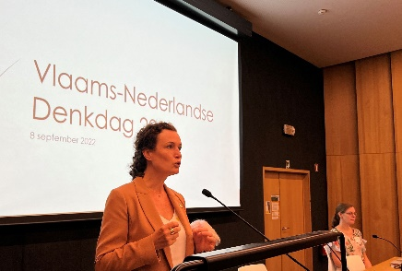
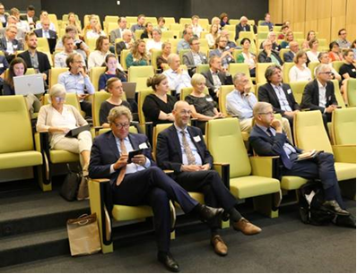
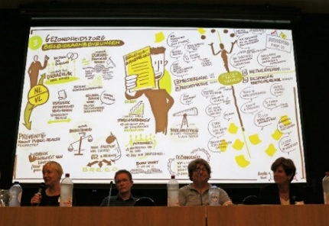
Explore example
Science-to-Policy dialogue
What
Output
Enabling scientists and policymakers to engage in strategic conversations and develop anticipatory intelligence
Knowledge exchange and mutual learning
SAM skills for young researches
Scientific papers including policy recommendations
Why
Topics 2022 edition
Artificial intelligence
Labour market and integration
Healthcare
Food, environment and climate
Strategic autonomy and international security
Supporting evidence-informed policy making with a focus on resilience
Insights of the 2022 edition (8/9/22, Leuven) were published in the Flemish Journal for Government Management (VTOM 2022-4)

Slide 13
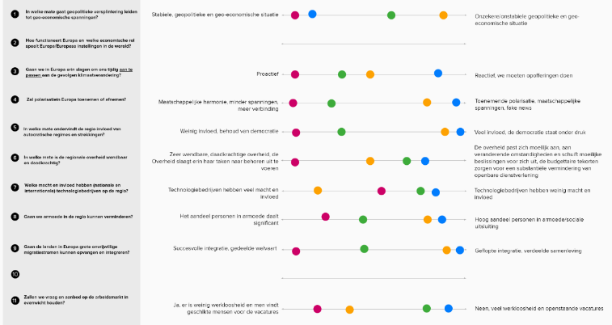
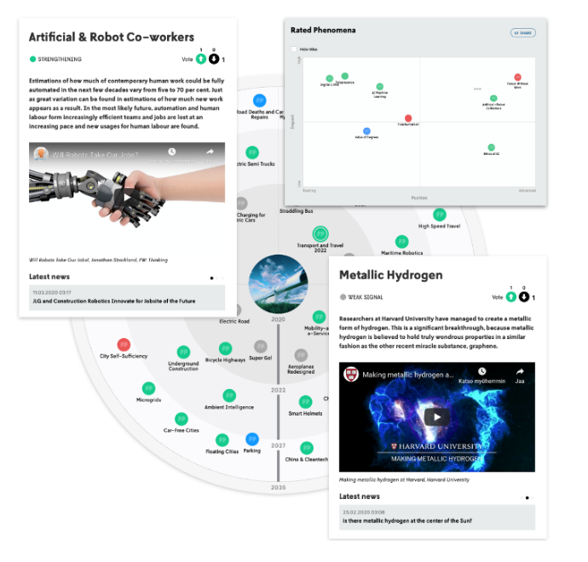
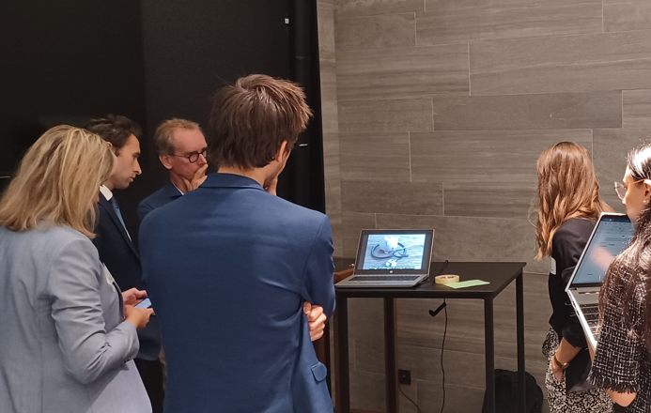
Mapping example
Explorative scenarios for a resilient Europe
United EU
SMART OPTIMISM
HYPER COMPETITION
SILVER SPERES
URBAN FLOWS
Innovation
leader
Innovation follower
Fragmented EU
Trend analysis Horizon scanning Scenario workshops

Slide 14
Europe, let's
cooperate!
Interregional cooperation forum

